Slide 1
EE204: Computer Architecture
Lecture 1

Slide 2
Instructor Profile (1)
Dr Aamir Shafi
Email: aamir.shafi@nu.edu.pk
Office: C140 (Civil Block)
Office Hours:
  Monday: 9 to 10 AM
  Wednesday: 9 to 10 AM

Slide 3




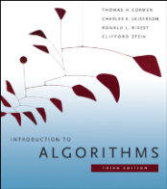

Instructor Profile (2)
Educational Background:
  BE in Software Engineering, MCS - NUST, ’03
    Rector’s Gold Medal
  PhD, ICG, University of Portsmouth, UK, ‘06
  Fulbright Visiting Scholar, MIT, USA, ‘11
  Tech Lead at xFlow Research, ‘11 – ‘12
Experience:
  Assistant Professor, SEECS, NUST, Jan ’07 – Aug ’15
    Led the High Performance Computing (HPC) research group
  Assistant Professor, Imam Abdulrahman Bin Faisal University (IAU), Aug ’15 – Aug ‘18
Architect/main developer of the MPJ Express software (http://mpjexpress.org)

Slide 4
Course Information
Credit Hours: 3
Course Type: Core
Pre-requisites: Digital Logic Design
Class Venue: CS-11
Section # | Lecture 1 | Lecture 2
Section C | Tuesday (12:30 to 1:50 PM) | Thursday (12:30 to 1:50 PM)

Slide 5
Course Objectives
The main objective of this course is to provide a profound understanding of the architectural design and internal working of a microprocessor which will allow computer science students to appreciate concepts like optimization and hardware level performance issues.
This course also introduces advanced concepts like pipelining and superscalar architecture and techniques like microprogramming.
Multi-Core processors and issues related to multicore processors are introduced.

Slide 6
Textbook
Course Textbook:
  M. Morris Mano, Computer System Architecture 3rd Edition 1993, Prentice Hall
  David A. Patterson, John L. Hennessy, Computer Organization and Design: The hardware/software interface, 5th Edition
Additional references:
  Modern Processor Design: Fundamentals of Superscalar Processors by John Paul Shen and Mikko H. Lipasti

Slide 7
Lecture-wise Topics
Lect # | Topics to be covered
1 | Introduction to basic hardware components and devices a) Digital Logic Design Review i) Boolean Algebra , ii) Combinational Circuits, iii) Sequential Circuits
2 | Frequently used components in computers a) Adders, b) Decoders, c) Multiplexers, d) Registers (Parallel load with shifts), e) Counters Number Systems and Binary Representations a) Integer Representations, b) Floating point representation
3 | Logic Operations Shift Operations Combined Arithmetic, Logic and Shift Unit.
4 | Additional Arithmetic Operations: a) Integer Multiplication, Division b) Floating Point Operations (Addition)
5 | Complete ALU and FPU design Introduction to Machine Language Central processing unit in detail a) General register organization, b) Addressing modes, c) CISC Vs RISC
6 | Computer Instructions and instruction codes Introduction to the MIPS Assembly Language Instruction Types 1) Arithmetic Instructions, 2) Memory Reference, 3) Branch Instructions

Slide 8

Lect # | Topics to be covered
7 | Design of a Single Cycle Machine 1) Register File, 2) ALU 3) Instruction and Data Memory 4) Control Unit 5) Integration of Units
8 | Single Cycle Machine Design Continued, Control Unit (As a hardwired combinational circuit), Exceptions and Interrupts
9 | Revision for Mid 1
10 | Multi-cycle implementation Motivation and Hardware Differences
11 | Enhancing Performance with Pipelining a) Introduction to pipelining b) A pipelined data-path c) Pipelined Control d) Shallow and deep pipelining
12 | Multi-cycle Continued, Control Unit State for each instruction type, Pipelined Machine: Hardware and Control Unit
13 | Multi-cycle Continued, Control Unit State Machine combined, Exception Handling in Multi-Cycle machine
14 | Data Hazards a) RAW (covered in detail) b) WAR c) WAW
15 | Control Hazards a) Branch Prediction, Performance of pipelined systems
16 | Understanding Performance a) CPU Performance b) Benchmarks c) Evaluating Performance
17 | Superscalar Processors.Basic concepts of superscalar processors and instruction independence
18 | Step by step execution of instructions in superscalar processors.
19 | Code Rescheduling Loop Unrolling

Slide 9
Lect # | Topics to be covered
21 | Cache Design: Memory Hierarchy basic concepts Basics and Direct mapped caches
22 | Cache Design: Associative Caches and Miss Rates
23 | Cache Design: Processor performance evaluation with cache / Multi-level Caches.
24 | Virtual Memory
25 | Multicores, Multiprocessors, and Clusters Multi-processor Systems basics. Multi-processor system types Parallel Processing Programs
26 | Intro to memory sharing models and cache coherence problem Clusters and Other Message-Passing Multiprocessors
27 | Hardware multithreading SISD,MIMD,SIMD,SPMD
28 | GPUs
29 | NVIDIA GPU architecture
30 | Revision for Final

Slide 10
Grading Criteria
3-4 Assignments (10%)
4-5 Quizzes (15%)
1-2 Midterm Exam(s) (30%)
Final Exam (45%)

Slide 11
Course Policies
Quizzes may be un-announced.
No makeup for missed quiz or assignment.
80% attendance
Academic integrity is expected of all the students. Plagiarism or cheating in any assessment will result in negative marking in that assessment (as per its weightage) OR more severe penalties.

Slide 12
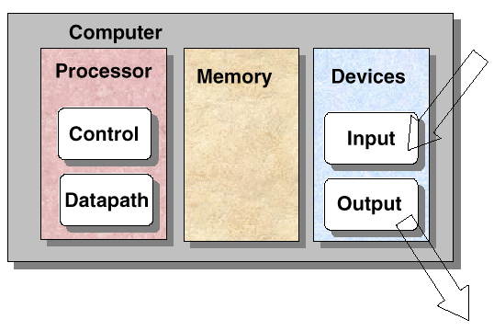
A Simple Picture

Slide 13
1-1 Digital Computers
Digital – A limited number of discrete value
Bit – A Binary Digit
Program – A Sequence of instructions
Application S/W
API
Operating System
ROM BIOS
Computer H/W

Slide 14
1-1 Digital Computers
Computer Hardware
  CPU
  Memory
    Program Memory(ROM)
    Data Memory(RAM)
  I/O Device
    Input Device: Keyboard, Mouse, Scanner
    Output Device: Printer, Plotter, Display
    Storage Device(I/O): FDD, HDD, MOD
Memory
CPU
Input
Device
Interface
Output
Device
Figure 1-1 Block Diagram of a digital Computer

Slide 15
1-1 Digital Computers
What is “Computer Architecture”?
- Hennessy and Patterson, Computer Organization and Design(1990)
  Computer Architecture
    Instruction Set Architecture (ISA)
    Machine Organization
“ISA”?
  Instructions
  Addressing modes
  Instruction and data formats
  Register
“Machine Organization”?
  CPU(Control, Data path), Memory, Input, Output
  How these components are arranged?

Slide 16
1-2 Logic Gates
ADC(Analog to Digital Conversion)
  Signal Physical Quantity Binary Information
  V Discrete Value
Gate
  The manipulation of binary information is done by logic circuit called “gate”.
Fig. 1-2 Digital Logic Gates
  AND, OR, INVERTER, BUFFER, NAND, NOR, XOR, XNOR
0 : 0.5
1 : 3

Slide 17
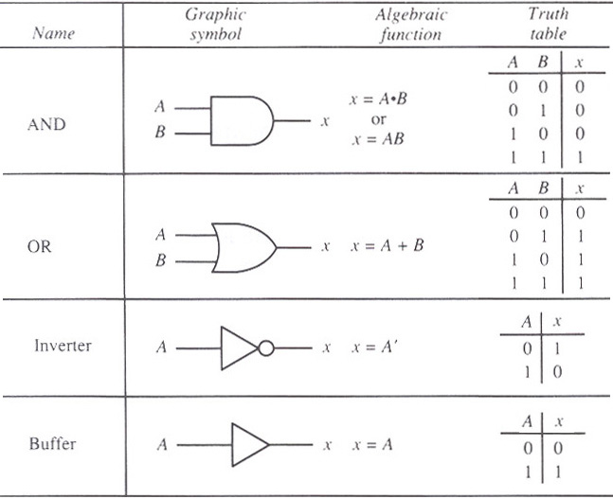
1-2 Logic Gates

Slide 18
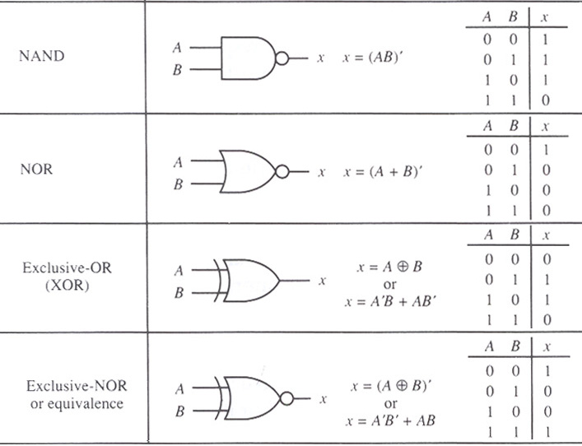
1-2 Logic Gates

Slide 19
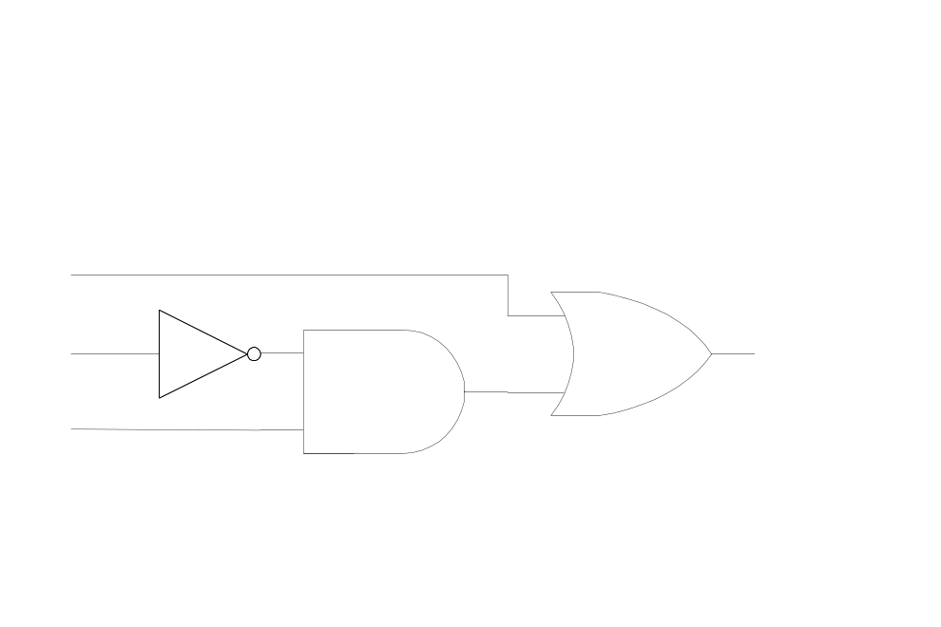
1-3 Boolean Algebra
Boolean Algebra
  Deals with binary variable(A, B, x, y: T/F or 1/0) + logic operation(AND, OR, NOT…)
Boolean Function: variable + operation
  F(x, y, z) = x + y’z
Truth Table: Fig. 1-3(a) Relationship between a function and variable
Logic Diagram: Fig. 1-3(b) Algebraic Expression
Logic Diagram(gates)
x
y
z
F
0
0
0
0
x
0
0
1
1
0
1
0
0
y
F
2^{n} Combination
Variable n = 3
0
1
1
0
1
0
0
1
z
1
0
1
1
1
1
0
1
1
1
1
1

Slide 20
1-3 Boolean Algebra
Purpose of Boolean Algebra
  To facilitate the analysis and design of digital circuit
Convenient Tools
  Truth table : relationship between binary variables
  Logic diagram : input-output relationship
  Find simpler circuits for the same function
Boolean Algebra Rule : Tab. 1-1
- Operation with 0 and 1: x + 0 = x , x + 1 = 1 , x • 1 = x , x • 0 = 0
- Idempotent Law: x + x =x , x • x = x
- Complementary Law: x + x' = 1 , x • x' = 0
- Commutative Law: x + y = y + x , x • y = y • x
- Associative Law: x + (y + z) = (x + y) + z , x • ( y • z) = (x • y) • z
- Distributive Law: x • ( y+ x) = (x • y) + (x • z) , x + (y • z) = (x + y) • (x + z)
- DeMorgan's Law: (x + y)' = x' • y’ , (x • y )’ = x’ + y’
General Form: (x1 + x2 + x3 + … xn)' = x1' • x2' • x3' • … xn’
(x1 • x2 • x3 • … xn) ' = x1' + x2' + x3' + … xn’

Slide 21
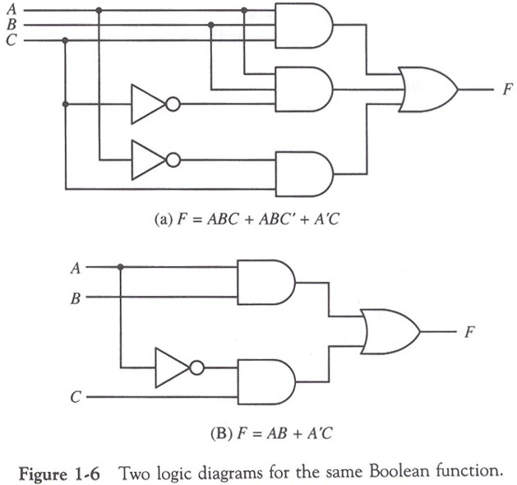
1-3 Boolean Algebra
Fig. 1-6(a)
[Example 2]
  F= ABC + ABC’ + A’C
  = AB(C + C’) + A’C
  = AB + A’C
Fig. 1-6(b)

Slide 22
1-5 Combinational Circuits
Combinational Circuits
  A connected arrangement of logic gates with a set of inputs and outputs
  Fig. 1-15 Block diagram of a combinational circuit
Analysis
  Logic circuits diagram Boolean function or Truth table
i
f
0
0
i
Combinational
Circuits
(Logic Gates)
f
1
. . .
. . .
1
i
f
n
m
Experience

Slide 23
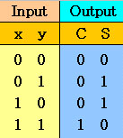

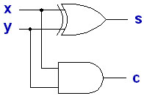
1-5 Combinational Circuits
Design Example : Half Adder
  1. Half adder is a combinational circuits that forms the arithmetic sum of two input bit
  2. 2 Input(x, y), 2 Output(S: sum, C: carry)
  3. Truth Table
  4. Simplification
      C= xy
      S= x’y + xy’
      =x ⊕ y
  5. Logic circuit diagram
  6. Block diagram
X
y
H.A
S
C

Slide 24
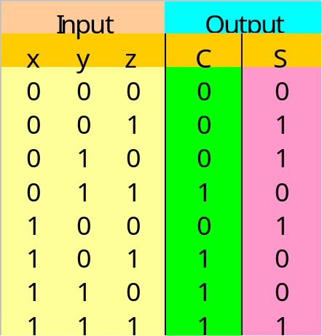
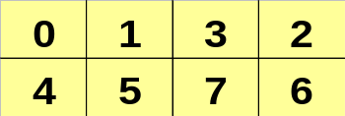
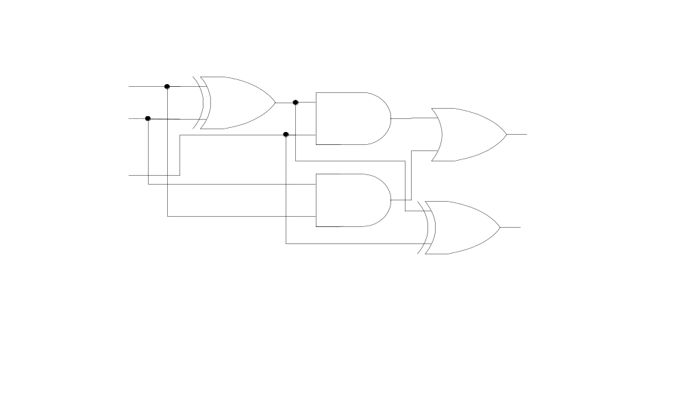
1-5 Combinational Circuits
Design Example : Full Adder
  1. Full adder is a combinational circuits that forms the arithmetic sum of three input bit(Carry considered)
  2. 3 Input(x, y, z), 2 Output(S: sum, C: carry)
  3. Truth Table
  4. Simplification
y
y
x
x
z
z
      C= xy’z + x’yz + xy
      =z(xy’ + x’y) + xy
      =z(x ⊕ y) + xy
      S=xy’z’ + x’y’z + xyz + x’yz’
      = z’(xy’ + x’y) + z(x’y’ + xy)
      = z’(x ⊕ y) + z(x ⊕ y)’
      =a’b + ab’ (let a=z, b=x ⊕ y)
      =x ⊕ y ⊕ z
  5. Logic circuit diagram
x
y
z
c
s
(x ⊕y)’=(xy’+x’y)’
=(x’+y)(x+y’)
=x’x+x’y’+xy+yy’
=x’y’+xy

Slide 25
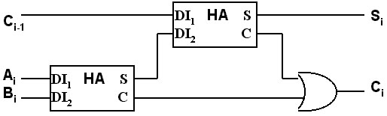
1-5 Combinational Circuits
X
Y
Z
F. A
S
C
Fig 1-18. Block diagram

Slide 26
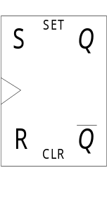
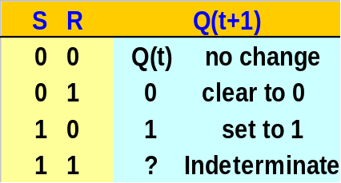
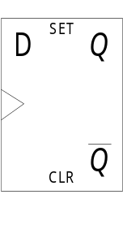
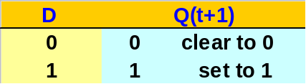
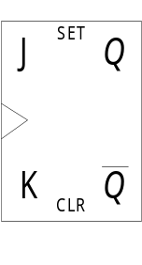
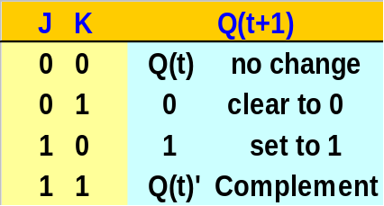
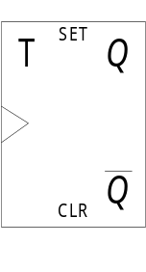
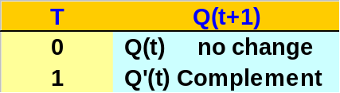
1-6 Flip-Flops
Combinational Circuit = Gate
Sequential Circuit = Gate + F/F
Flip-Flop
  The storage elements employed in clocked sequential circuit
  A binary cell capable of storing one bit of information
SR(Set/Reset) F/F
D(Data) F/F
JK(Jack/King) F/F
  JK F/F is a refinement of the SR F/F
  The indeterminate condition of the SR type is defined in complement
T(Toggle) F/F
  T=1(J=K=1), T=0(J=K=0)
  Q(t+1)= Q(t) ⊕ T

Slide 27
1-6 Flip-Flops
Positive clock transition
Edge-Triggered F/F
  State Change : Clock Pulse
    Rising Edge(positive-edge transition)
    Falling Edge(negative-edge transition)
ts th

Slide 28
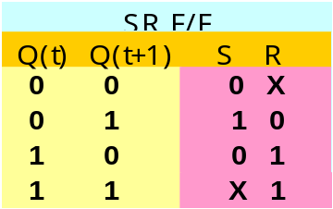
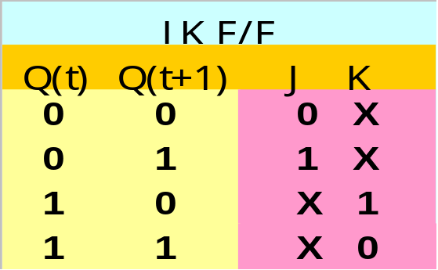
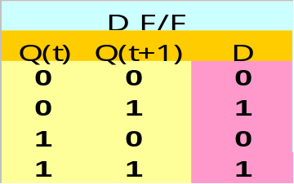
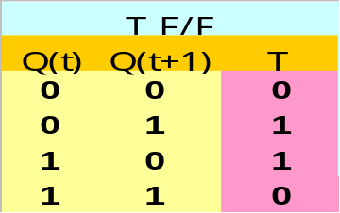
1-6 Flip-Flops
Excitation Table
  Required input combinations for a given change of state
  Present State Q(t), Next State Q(t+1)
Don’t Care
1 : Set to 1
0 : Complement
1 : Clear to 0
0 : No change

Slide 29
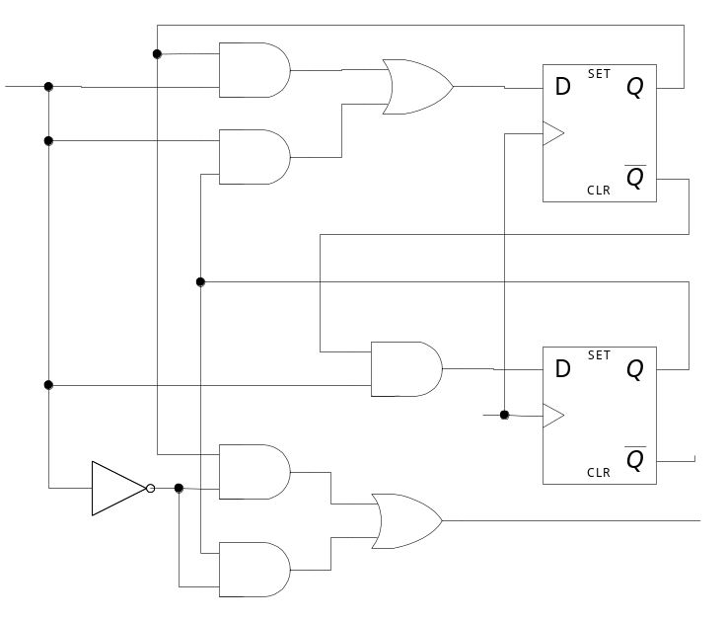
1-7 Sequential Circuits
A sequential circuit is an interconnection of F/F and Gate
Clocked synchronous sequential circuit
Flip-Flop Input Equation
  Boolean expression for F/F input
  Input Equation
    D_{A} = Ax + Bx, D_{B} = A’x
  Output Equation
    y = Ax’ + Bx’
  Fig. 1-25 Example of a sequential
  circuit
Combinational Circuit = Gate
Sequential Circuit = Gate + F/F
Input
Combinational
Circuit
Output
Flip-Flops
Clock
x
DA
A
A’
DB
B
B’
Clock
y

Slide 30
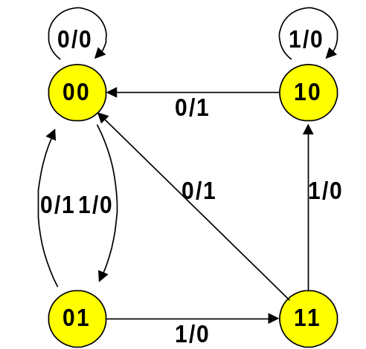
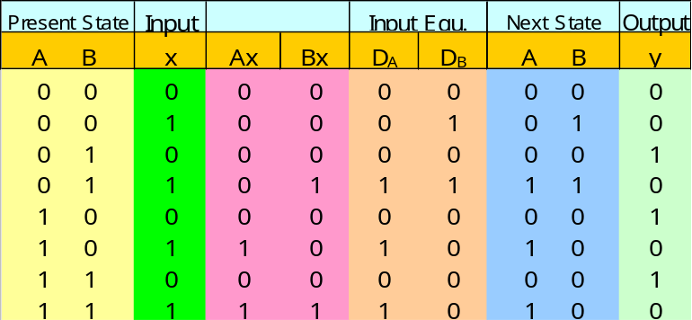
1-7 Sequential Circuits
x
DA
State Diagram
  Graphical representation of state table
    Circle(state), Line(transition), I/O(input/output)
A
A’
DB
B
B’
Clock
y
State Table
  Present state, input, next state, output

Slide 31
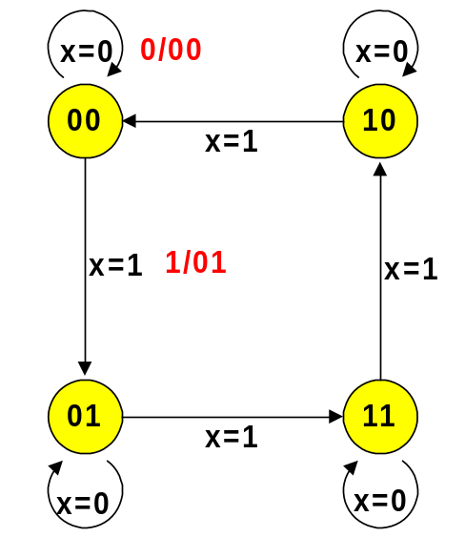
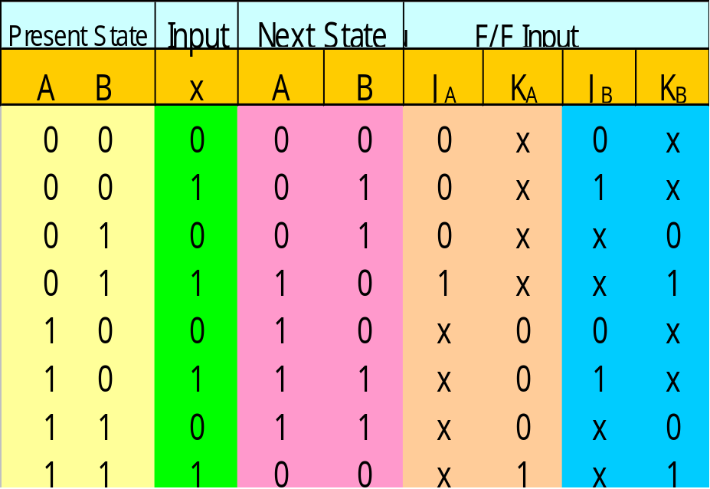
1-7 Sequential Circuits
Design Example: Binary Counter
Next State =
Output
  x=1: 00, 01, 10, 11,
  00, 01, …..
  x=0: no change
  State Diagram:
  4 state(00, 01, 10, 11)
  Excitation Table(2 bit counter = 2 F/F)

Slide 32
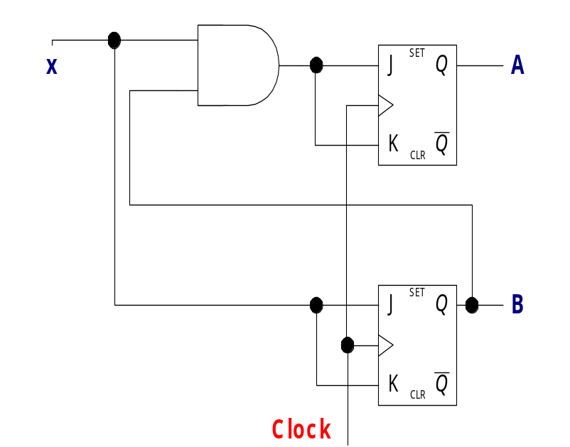
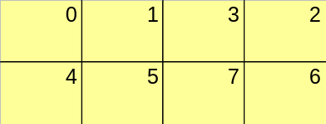
1-7 Sequential Circuits
  Map for simplification
    Input variable: A, B, x
  Logic Diagram
JA
B
KA
B
1
X X X X
A
X X X X
A
1
JA=Bx
x
KA=Bx
x
JB
B
KB
B
1
1
X X
X X
X X
X X
1
1
A
A
JB=x
x
KA=x
x
Sequential Circuit Design Procedure
  1. The Problem is stated
  2. I/O variables are assigned
  3. Truth table(I/O relation)
  4. Simplified Boolean Function
  5. Logic circuit diagram

